Slide 1
Statistical and Geospatial Modeling
Alejandro Ordonez
Assistant Professor - Department of Bioscience
Section for Ecoinformatics & Biodiversity
Centre for Biodiversity Dynamics in a Changing World (BIOCHANGE)
Centre for Sustainable Landscapes under Global Change (SustainScapes)

Slide 2
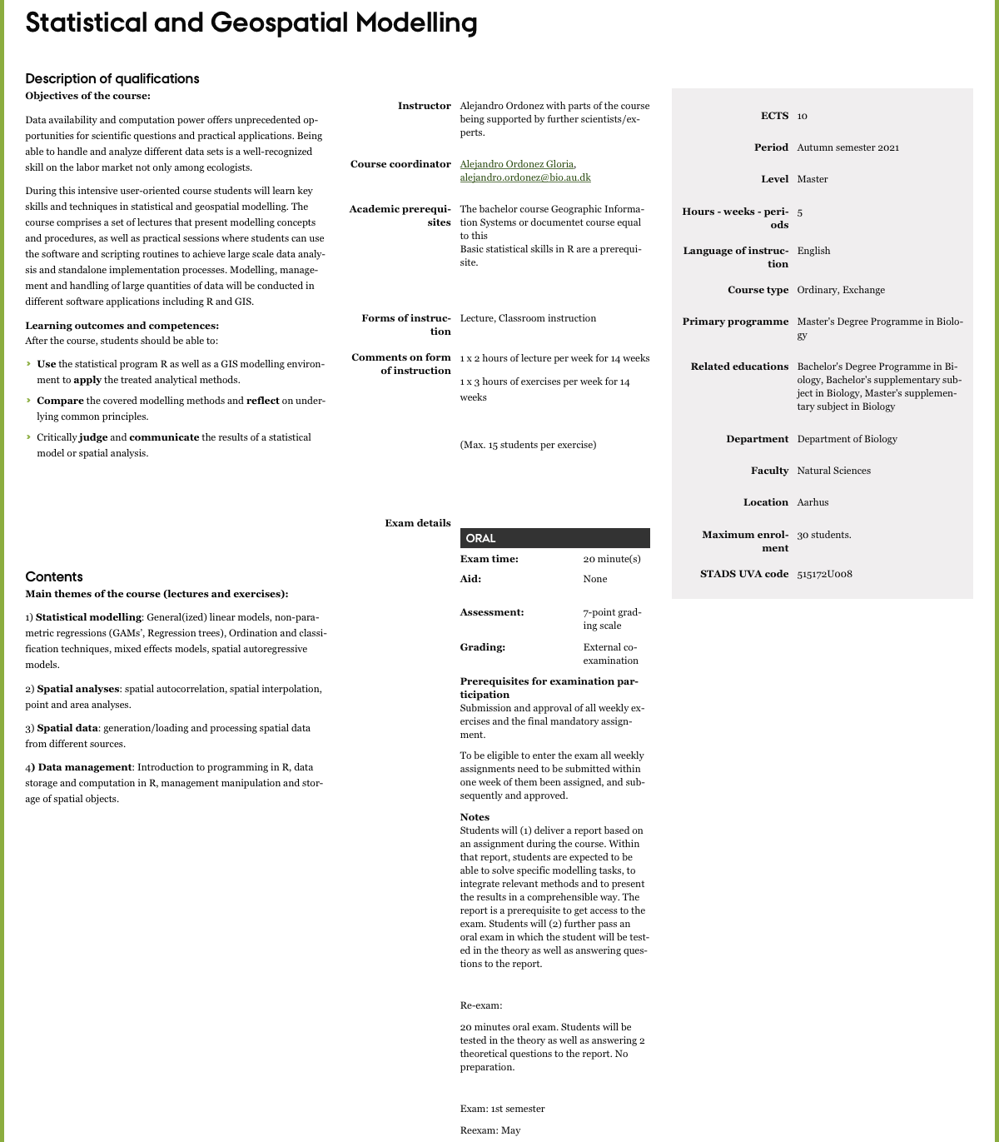
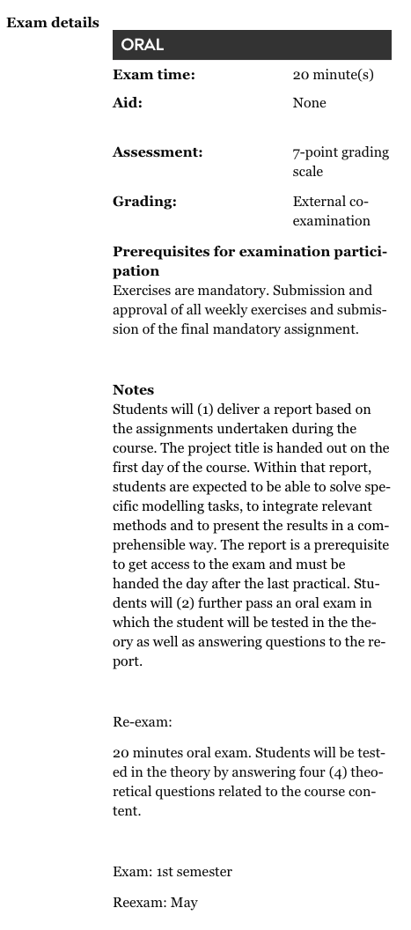
This is what you usually care about!

Slide 3
The basics where?, What?, how?, who?
The Where?
Lectures (Auditorium D4; 1531-219) – Tuesday 10:00-12:00
Practical (1521-318) – Thursday:
[Group 1 – 9:00 - 12:00]
[Group 2 – 13:00 - 16:00]

Slide 4
The basics where?, What?, how?, who?
The What?
Course work.
Week 1 to 7: statistical modelling Focused.
Week 8 to 13: Geospatial modelling Focused.
Week 14: Project Preparation.
Project.
The project is an ongoing process throughout the course practical sessions.
At the end of the course you have ONE week to put together a final report
This is HALF! of your ticket to the exam!

Slide 5

The basics where?, What?, how?, who?
The how? Textbooks.
University has online access to these books

Slide 6
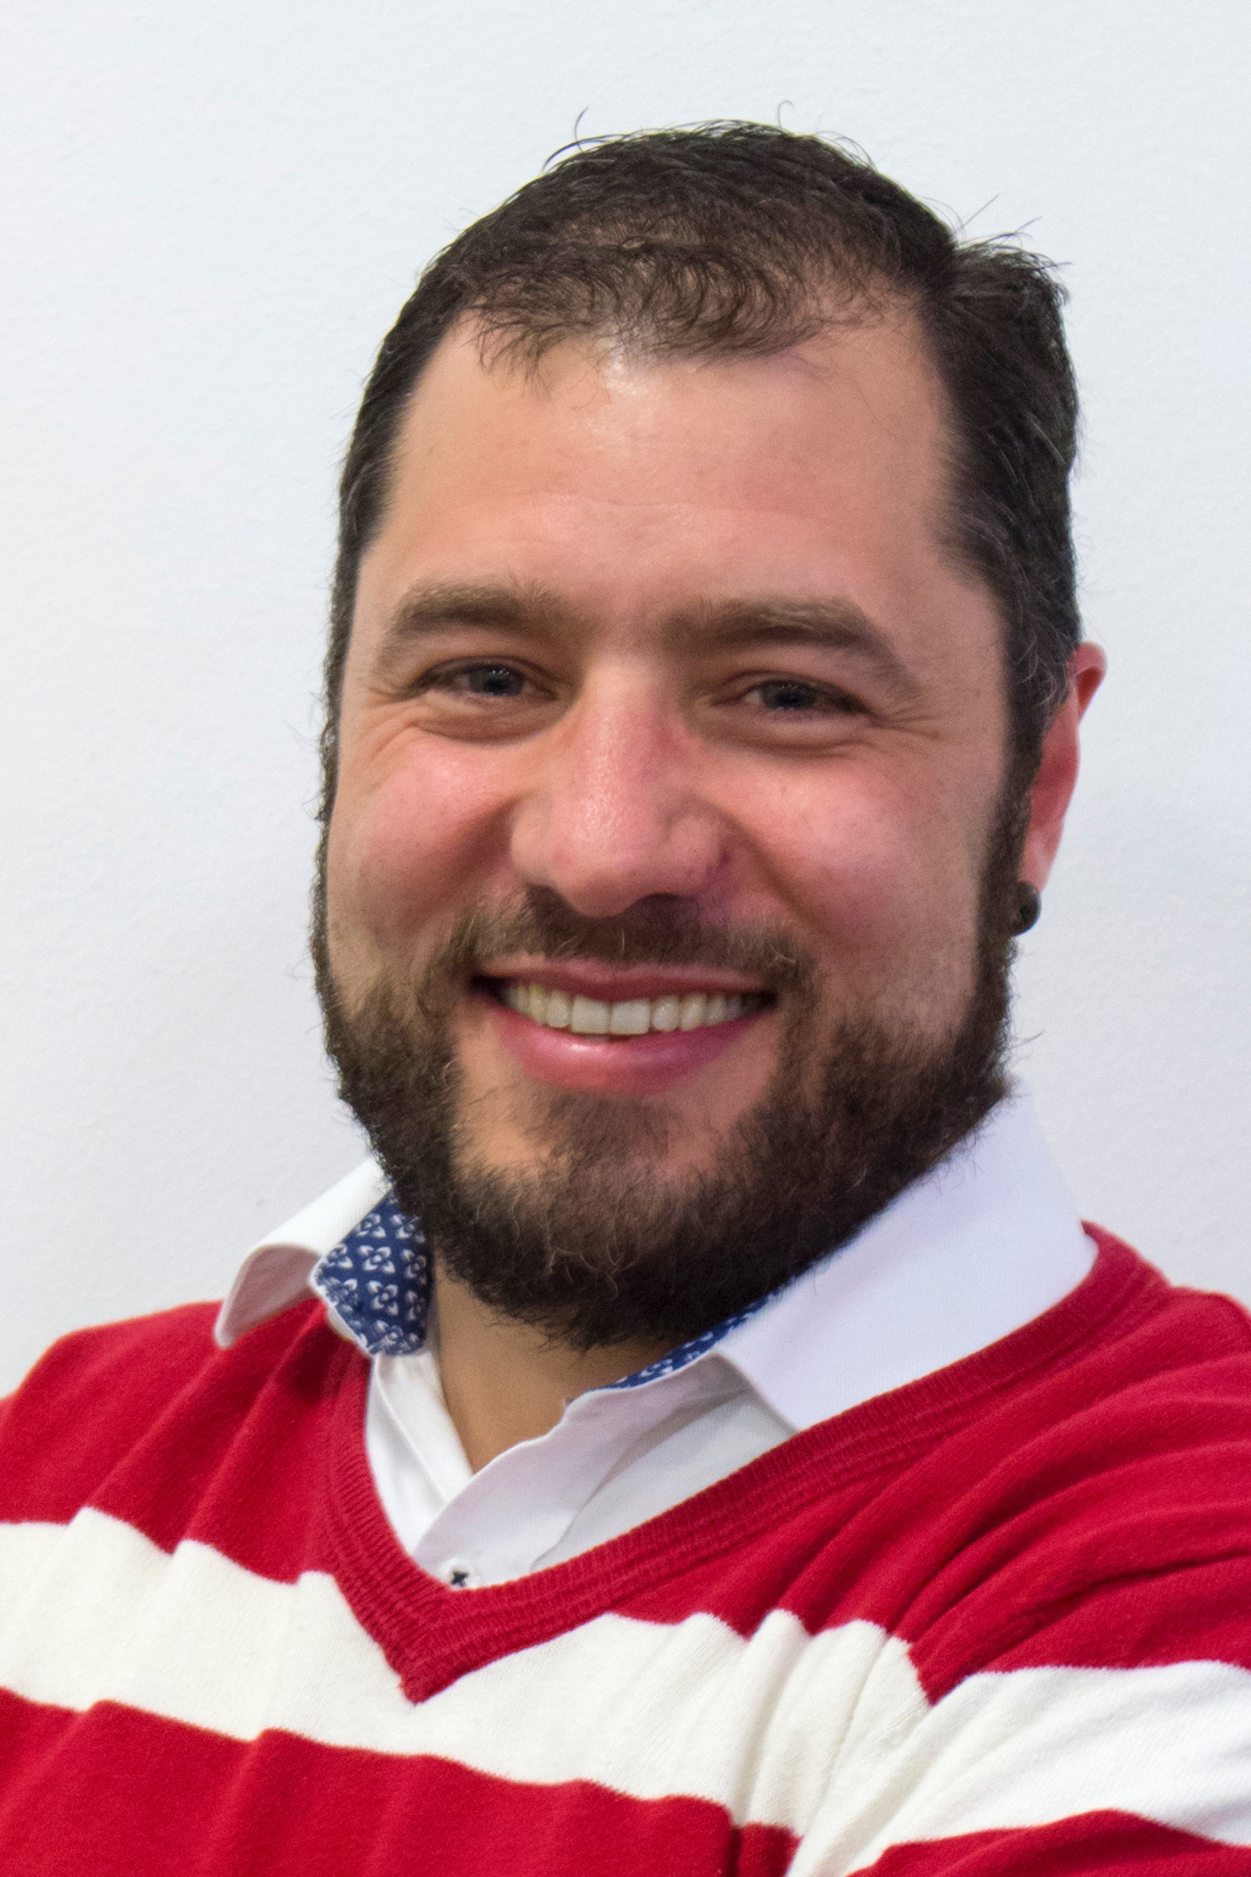

The basics where?, What?, how?, who?
The Who?
Alejandro Ordonez
<alejandro.ordonez@bio.au.dk>
Hanne Dalsgaard Nicolaisen
<hanne.nicolaisen@bio.au.dk>

Slide 7
Rules of engagement statistical modeling
You MUST come to class.
You MUST come to the practical
you must show up for at least 80% of the classes.
Exercises are long and hard
The goal of the practical is not only to produce a summary of your code and interpretation as a R-markdown document
I will be asking about the technical aspects of these in the exam
Ask if you need help But WE WILL NOT WRITE THE CODE FOR YOU!

Slide 8
Rules of engagement statistical modeling – FINAL PROJECT
During the course, you will build up the skills needed to address write your final report [week 49]
The project is summarizing the skills you have been gaining trough the course.
99% the work already done throughout the course – the practical sesions
Last week is to try top condense it into a final report.
The report is 2000 words max [~ 5 pages Inc figures]
12-point Times New Roman, 2.5cm margins, single space, 6pnt between paragraphs
Report quality matters but is not a percentage of your exam mark.
The REPORT and the PRACTICALS are your ticket to the exam

Slide 9
ALL clear?
Any questions?
Ready to Start?

